Slide 1
CS F372 Operating Systems
17 – Memory management – Paging

Slide 2
Text Book Reading
Chapter 8
Sections 8.5.1, 8.5.2, 8.5.3

Slide 3
Paging
Memory management scheme that lets physical address space of a process to be noncontiguous
Process is allocated physical memory wherever it is available
Divide physical memory into fixed-sized blocks called frames (size is power of 2)
Divide logical memory into blocks of same size called pages

Slide 4
Paging
To run a program of size n pages, need to find n free frames and load the pages of the program into the frames
A page table is used to translate logical to physical addresses
Every process has a page table
Page table
Indexed by the page number
Stores the base address of each page in physical memory (or) the frame number

Slide 5
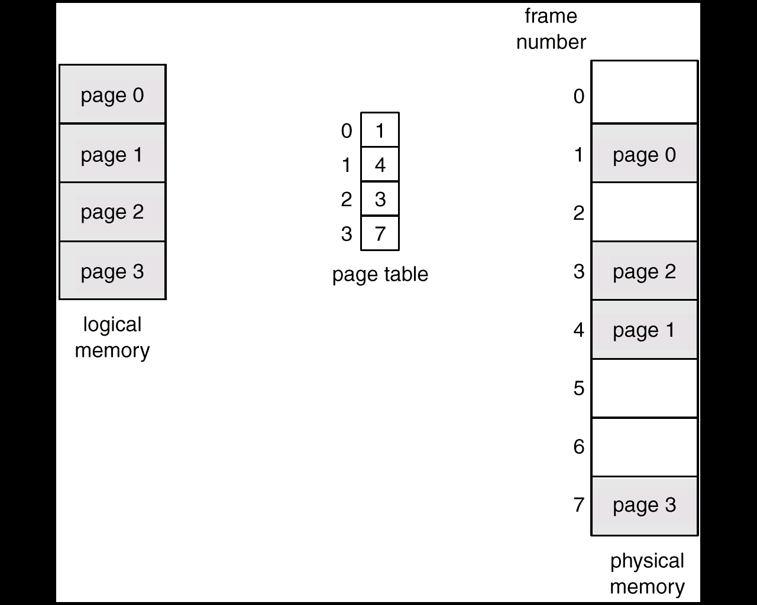
Paging Example

Slide 6
Address Translation Scheme
Logical address generated by CPU is divided into
Page number (p) – used as an index into a page table which contains base address of each page in physical memory
Page offset (d) – combined with base address to define the physical memory address that is sent to the memory unit

Slide 7
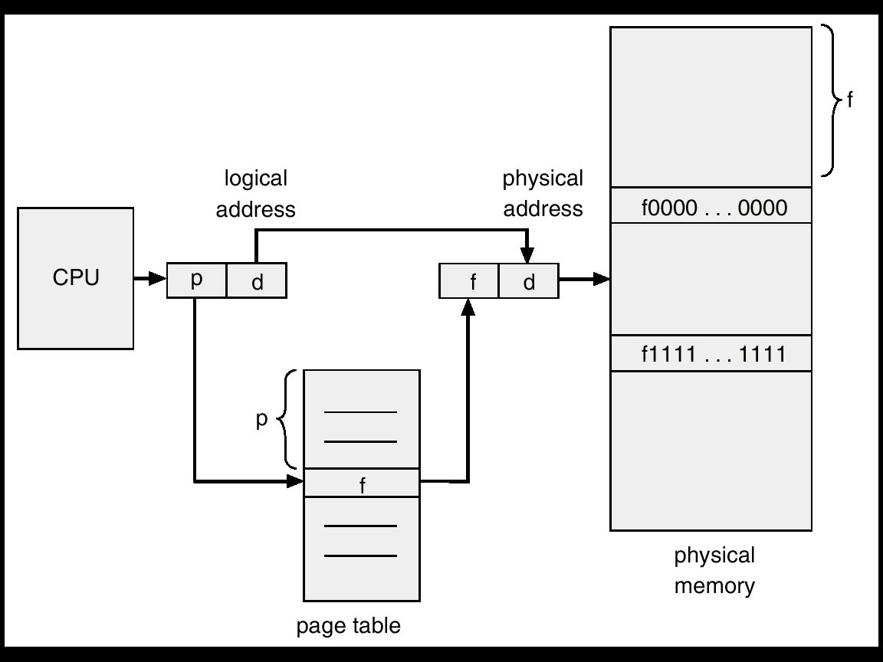
Address Translation Architecture

Slide 8
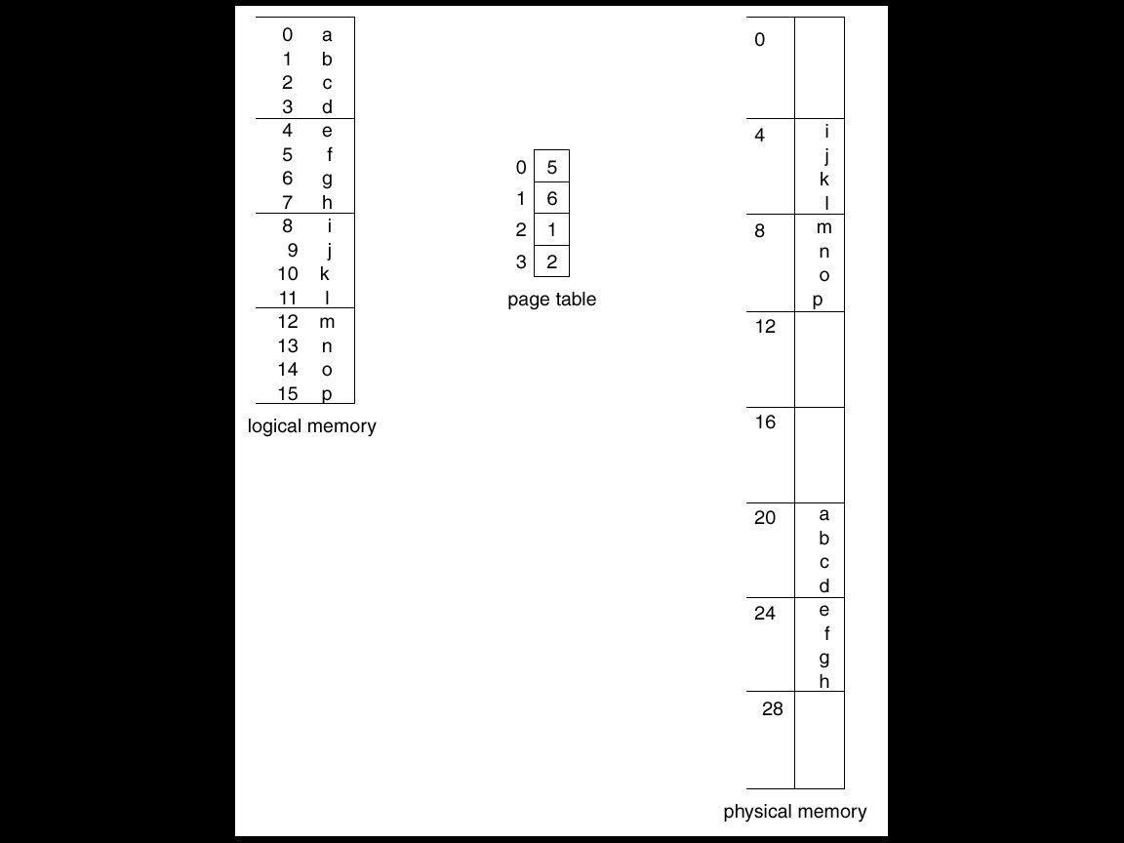
Address Translation Architecture

Slide 9
Address Translation Architecture
4 bytes page size
4 = 2²
2 bits for offset
LA is 4 bits,
remaining 2 bits for page number
Logical address 1
p off
00 01
Logical address 10
10 10

Slide 10
Address Translation Architecture
Consider a logical-address space of eight pages of 1,024 words each mapped onto a physical memory of 32 frames. Assume 1 word = 1 byte.
How many bits in the logical address?
How many bits are in the physical address?

Slide 11
Address Translation Architecture
Consider a logical-address space of eight pages of 1,024 words each mapped onto a physical memory of 32 frames. Assume 1 word = 1 byte.
How many bits in the logical address?
How many bits are in the physical address?
Size of page = 1,024 words = 2¹⁰
Number bits for offset = 10
To address one of the 8 (23) pages, 3 bits needed
Logical address = 13 bits
To address one of the 32 (25) frames, 5 bits needed
Physical address = 15 bits

Slide 12
Paging
No external fragmentation
Internal fragmentation is possible
If size of process is not a multiple of page size, internal fragmentation is possible
If page size is 2048 bytes, size of process is 72, 766 bytes
Will need 36 frames – 35 full frames + 1086 bytes
Internal fragmentation of 2048 - 1086 = 962 bytes

Slide 13
Paging
Worst case n-1 bytes may get wasted if page size is n bytes
On the average one-half page gets wasted per process
Small page sizes are desirable
Number of page-table entries gets increased
Disk I/O is more efficient when the number of data being transferred is larger
Large page sizes are used now. ex. Solaris
Even on-the-fly page-size support has been proposed by researchers

Slide 14
Frame Table
Operating system maintains a frame table
Frame table has one entry for each physical page frame
Each entry gives details on whether the frame is free or allocated, if allocated, to which page of which process

Slide 15
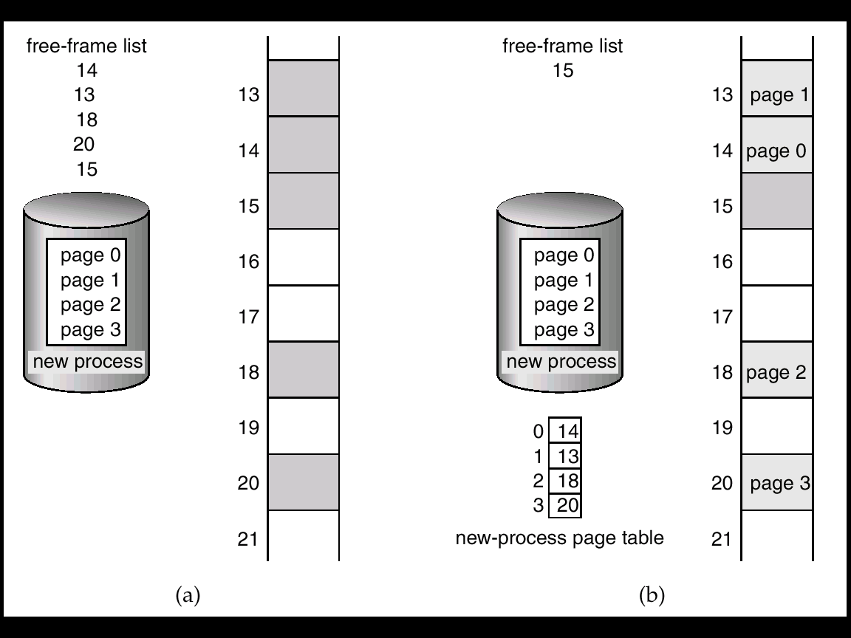
Free Frames

Slide 16
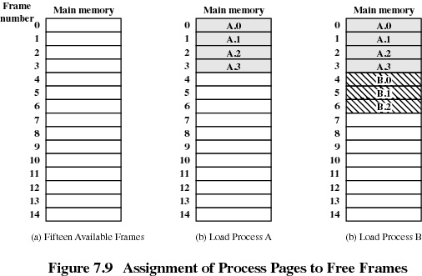
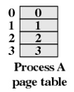
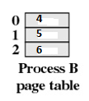

Slide 17
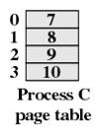
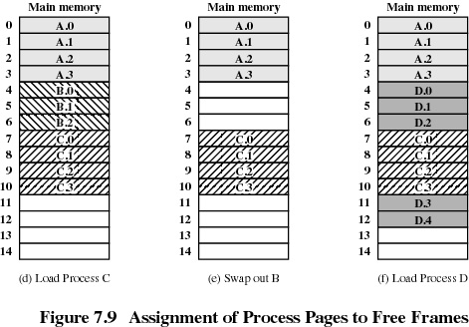
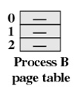
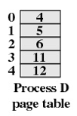


Slide 18
Implementation of Page Table
Page table kept in main memory
Page-table base register (PTBR) points to the page table
Changing the page table by the dispatcher requires changing only this register
Page-table length register (PTLR) indicates size of the page table
In this scheme every data/instruction access requires two memory accesses
One for the page table and one for the data/instruction.
Access is slowed down by a factor of 2

Slide 19
Implementation of Page Table
This problem can be solved by the use of a special, small, fast-lookup hardware cache called associative memory or translation look-aside buffers (TLBs)
64 or 128 locations/entries
Each entry has two parts – a key (tag) and a value
When presented with an item, it is compared with all keys simultaneously for a match
If a key is matched, the corresponding value is returned
Costly but faster

Slide 20
Paging with TLB
TLB
Tag field: page number
Value field: frame number
Address translation
Logical address has page no and page offset
Page number is compared with the tag field of the TLB
If page number is in TLB, then the frame number is got
Otherwise get frame number from page table in memory
Page number | Frame number

Slide 21
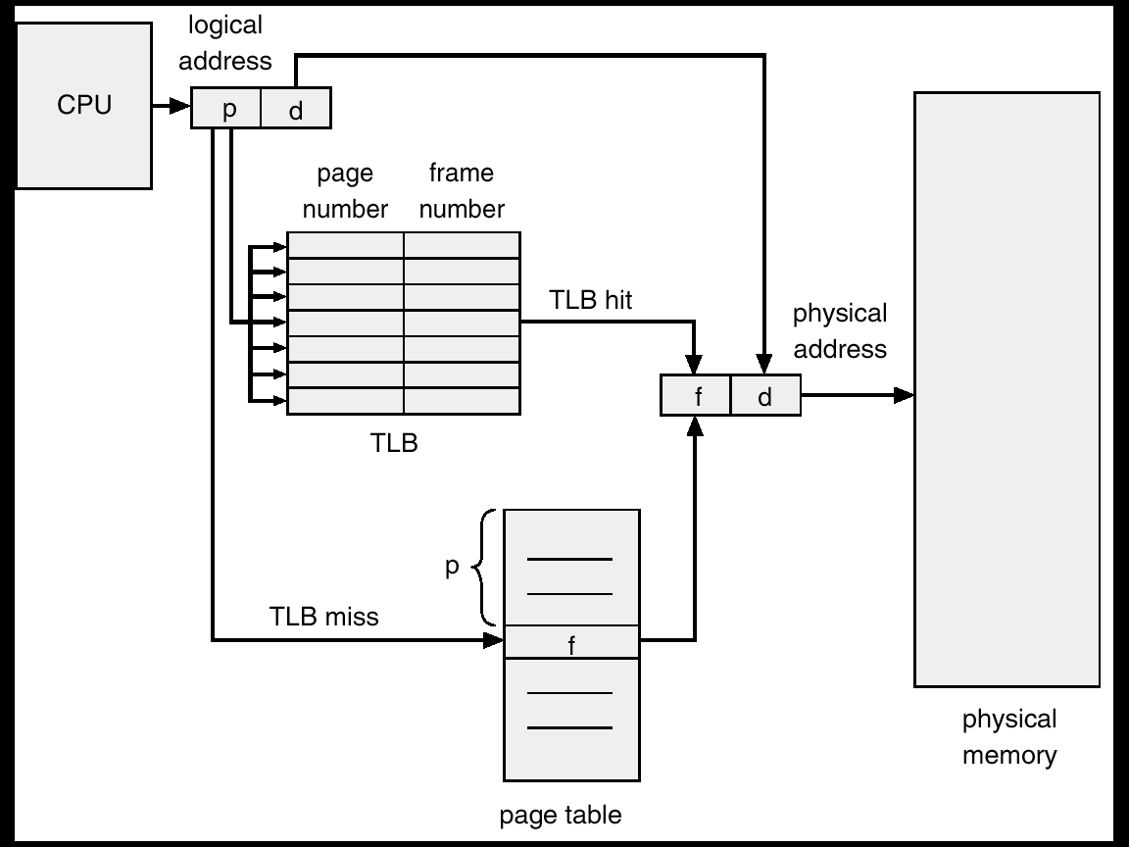
Paging Hardware With TLB

Slide 22
Paging with TLB
TLB hit
If page number is found in TLB
TLB Miss
If page not found in TLB (TLB miss)
Get the frame number from the page table present in the memory
Add this page no, frame no to the TLB to use in the next reference
If TLB is already full, select one entry for replacement
Replacement policies
Least Recently Used (LRU): the entry to be replaced is the one that is not used recently
Random
Round robin

Slide 23
Effective Access Time
Associative Lookup = ε time unit
Assume memory cycle time is 1 microsecond
Hit ratio α – Fraction of times a page number is found in the TLB
Effective Access Time (EAT)
EAT = (1 + ε) α + (2 + ε)(1 – α)
= 2 + ε – α

Slide 24
Effective Access Time
Example: Suppose it takes 20 nsecs to search TLB and 100 nsecs to access memory. If TLB hit ratio is 80 %, compute effective memory-access time
If page no. is present in the TLB, memory access time = 120 nsecs.
If page no. is not present in the TLB, memory access time = 220 nsec.
EAT/EMAT = 0.80 x 120 + 0.20 x 220 = 140 nsecs.

Slide 25
Memory Protection
Memory protection implemented by associating protection bit with each frame
Protection bits are kept in page table
Read-only, read-write
Read-only = 0
Read-write = 1
Trap on memory protection violation

Slide 26
Memory Protection
Valid-invalid bit attached to each entry in the page table:
“valid” indicates that the associated page is in the process’ logical address space, and is in main memory
“invalid” indicates that the page is
Not in the process’ logical address space (illegal) (or)
Legal but it is not present in the memory but it is present in the disk
Computer traps to the operating system

Slide 27
Memory Protection
Suppose, for example, that in a system with a 14-bit address space (0 to 16383 locations), we have a program that should use only addresses 0 to 12287. Given a page size of 2 KB, we have 8 possible pages.
But 12288 address at the max will need 12288/2048 = 6 pages
The remaining two pages are considered invalid

Slide 28
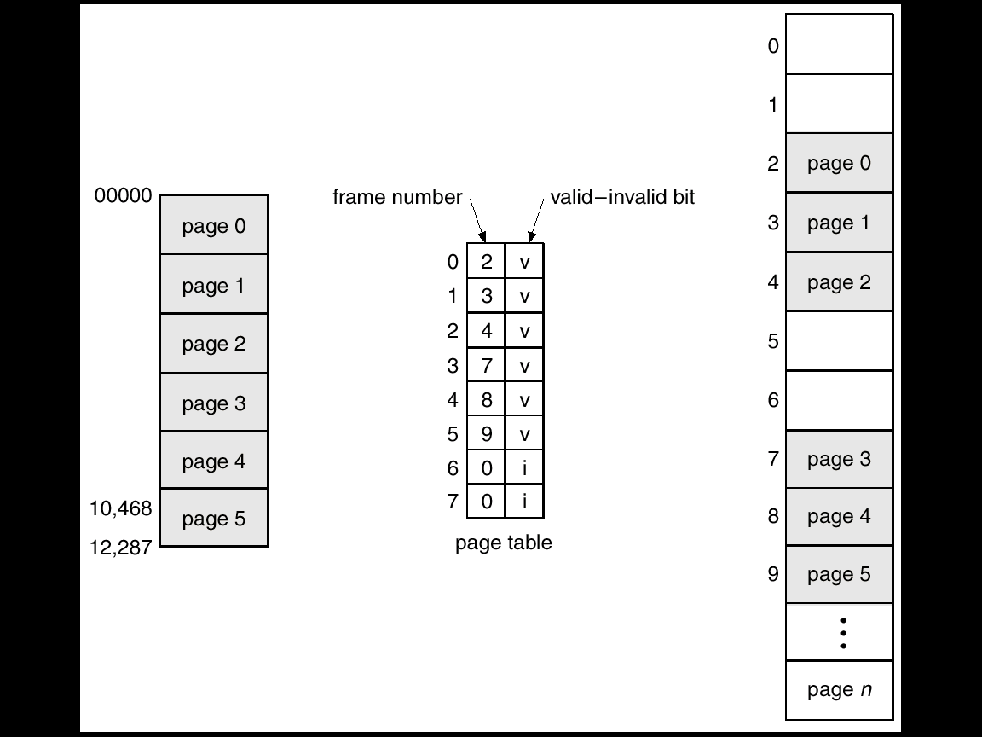
Valid (v) or Invalid (i) Bit In A Page Table

